Slide 1
Discrete decision making
Practice1. Confidence interval for probabilities of discrete choice

Slide 2

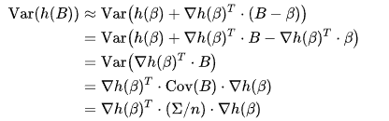
Delta method
Delta method is a result concerning the approximate probability distribution for a function of an asymptotically normal statistical estimator from knowledge of the limiting variance of that estimator. It was first described in 1938 by Robert Dorfman.
Suppose we want to estimate the variance of a function h of the estimator B. Keeping only the first two terms of the Taylor series, and using vector notation for the gradient, we can estimate h(B) as
which implies the variance of h(B) is approximately

Slide 3
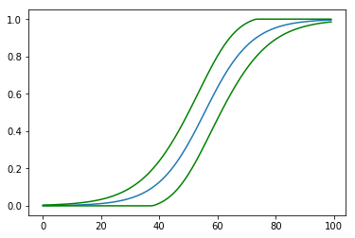
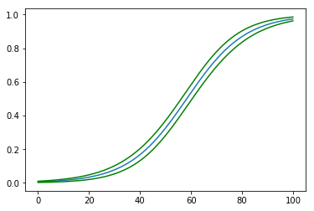
Example
Data:
K = 1
N = 100*K
np.random.seed(1)
x = np.arange(N)/K
y = (x * 0.5 + np.random.normal(size=N,scale=10)>30)
Method:
cov = model.cov_params()
gradient = (proba * (1 - proba) * X.T).T # matrix of gradients for each observation
std_errors = np.array([np.sqrt(np.dot(np.dot(g, cov), g)) for g in gradient])
c = 1.96 # multiplier for confidence interval
upper = np.maximum(0, np.minimum(1, proba + std_errors * c))
lower = np.maximum(0, np.minimum(1, proba - std_errors * c))
Result:
K=1
K=10

Slide 4
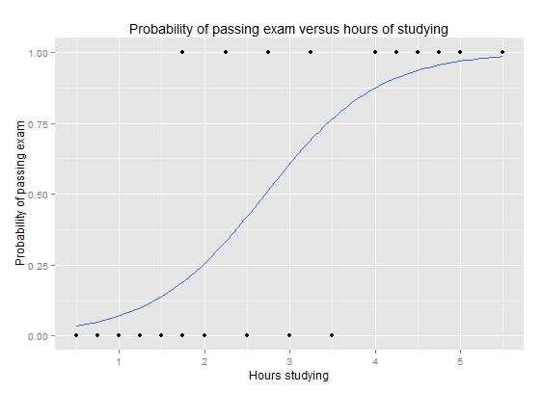
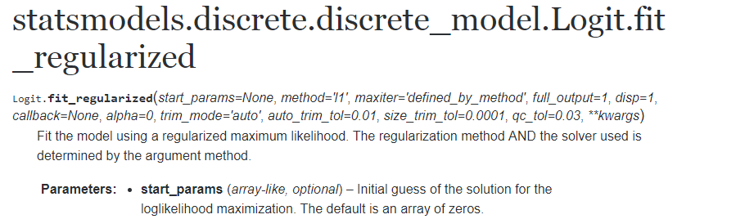
Task 1
Find confidence interval for probabilities of passing exam for 1-5 Hours of studying using Delta Method and regularized logit fit function.
https://www.statsmodels.org/dev/generated/statsmodels.discrete.discrete_model.Logit.fit_regularized.html

Slide 5
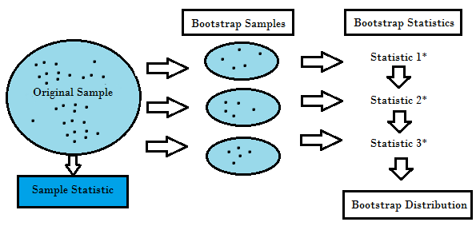
Bootstrapping estimation
Bootstrapping is any test or metric that relies on random sampling with replacement.

Slide 6
Task 2
Generate large sample from Exam task using uniform distribution generator and logit regression
Generate N samples of size len(hours) from main distribution
Estimate confidence interval for probabilities of passing exam for 1-5 Hours of studying using Bootstrapping
Compare results (confidence interval) with Task 1
Recommendation: use np.random.choice

